Slide 1
RAU Operating Systems 2015
Lab #4

Slide 2
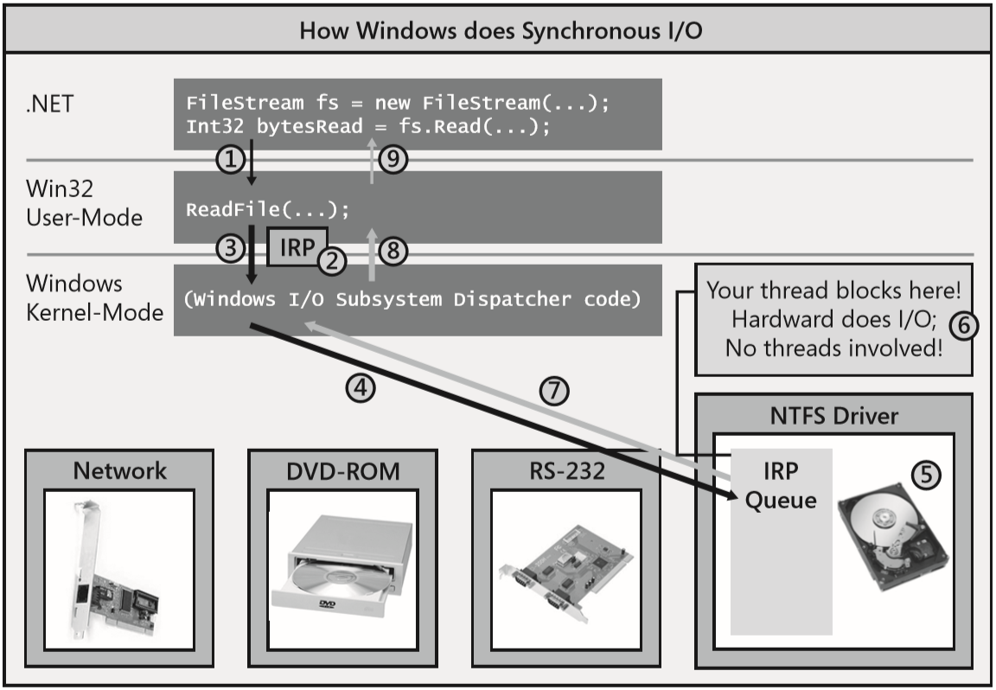
How Windows Performs I/O Operations
I/O Request Packet (IRP):
handle to the file
an offset within the file where bytes will start to be read from
the address of a Byte[] that should be filled with the bytes being read,
number of bytes to transfer
Etc.

Slide 3
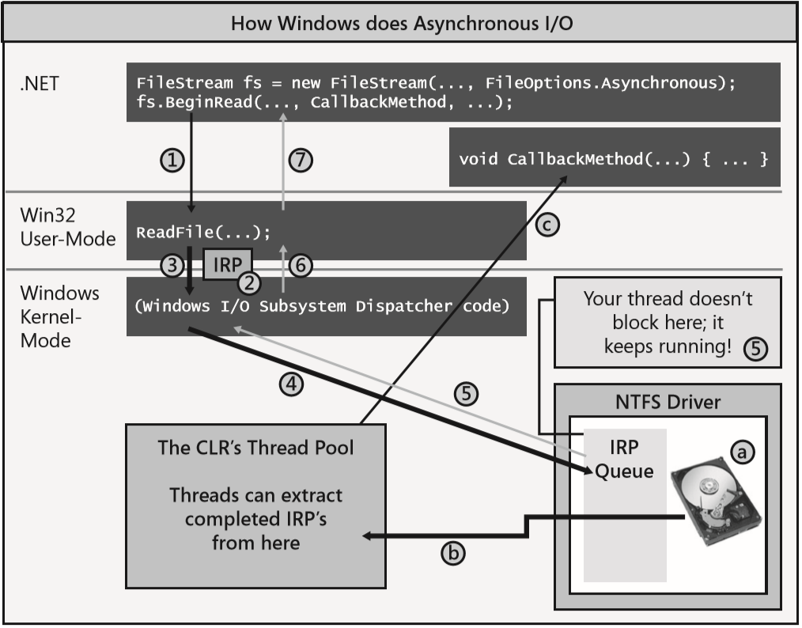
How Windows Performs I/O Operations(cont.)
ReadAsync internally allocates a Task<Int32> object to represent the pending completion of the read operation.

Slide 4
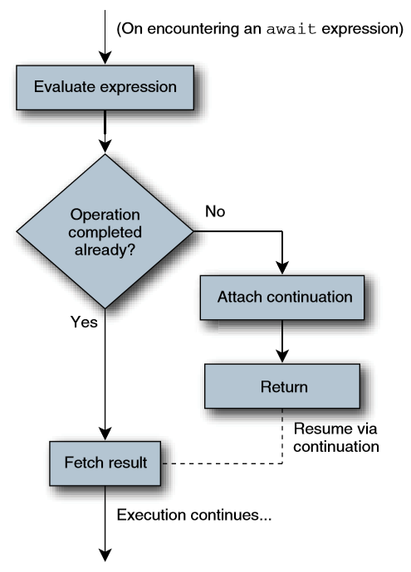
C# async/await
Performing asynchronous operations is the key to building scalable and responsive
Async keyword converts your code to a state machine, so it can be run then stopped and resumed later.
Async functions internally allocates a Task object and returns it back.
C# await operator effectively calls ContinueWith on the Task object passing in the method that resumes the state machine and then, the thread returns
Restrictions:
You cannot turn your application’s Main method into an async function. In addition, constructors, property accessor methods and event accessor methods cannot be turned into async functions.
You cannot have any out or ref parameters on an async function.
You cannot use the await operator inside a catch, finally, or unsafe block.

Slide 5
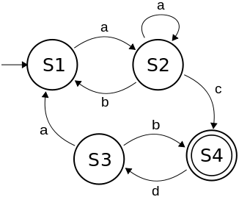
Reminder: Simple State Machine

Slide 6
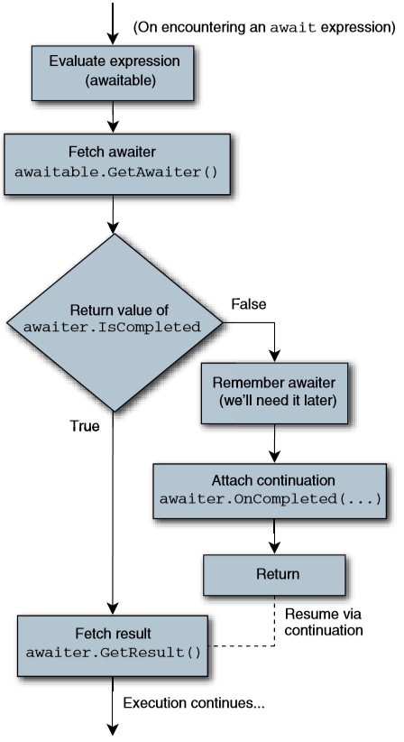
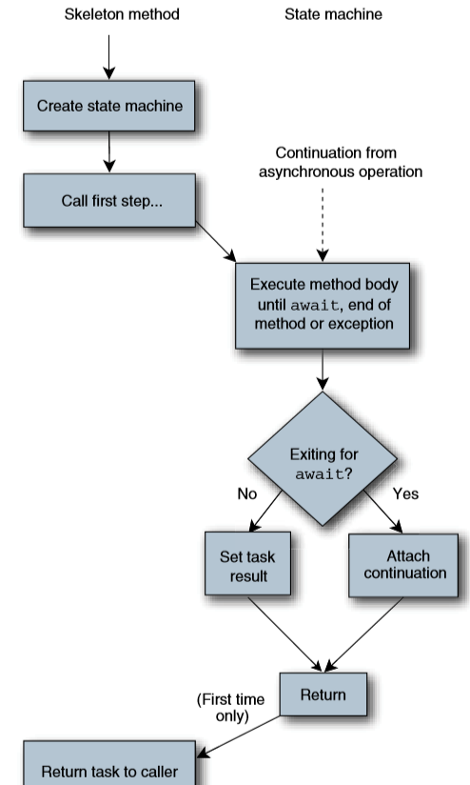
How the Compiler Transforms an Async Function into a State Machine
When compiling async method, the compiler transforms the code in that method to a state machine structure that is capable of being suspended and resumed.
Whenever you use the await operator in your code, the compiler takes the specified operand and attempts to call a GetAwaiter method on it.

Slide 7
Async Functions in the Framework Class Library
By convention, Async is suffixed onto the method’s name.
In the Framework Class Library (FCL), many of the types that offer I/O operations offer XxxAsync methods
All the System.IO.Stream-derived classes offer ReadAsync, WriteAsync, FlushAsync, and CopyToAsync methods.
The System.Net.Http.HttpClient class offers GetAsync, GetStreamAsync, GetByteArrayAsync, PostAsync, PutAsync, DeleteAsync, and many more.
All System.Net.WebRequest-derived classes (including FileWebRequest, FtpWebRequest, and HttpWebRequest) offer GetRequestStreamAsync and GetResponseAsync methods.
While looking through the FCL, you might notice some classes that are lacking XxxAsync methods and instead only offer BeginXxx and EndXxx methods. Use Task.Factory.FromAsync method to convert the BeginXxx and EndXxx model to the new Task-based model.
For the old event-based programming model, the FCL does not include any helper methods to adapt this model into the new Task-based model. But this can be done manually.
Demo

Slide 8
Async Functions and Exception Handling
When a Windows device driver is processing an asynchronous I/O request, it is possible for something to go wrong, and Windows will need to inform your application of this.
When using await with a Task, the first inner exception is thrown instead of an AggregateException.
If your state machine method experiences an unhandled exception, then the Task object representing your async function completes due to the unhandled exception. Any code waiting for this Task object to complete will see the exception

Slide 9
Async Function Features
Integrated debugging support for async functions in the Visual Studio IDE.
Async functions’ state machine may work synchronously when I/O complete relatively fast.
Best practice. Async function may have an intensive amount of processing before call an asynchronous I/O operation. In this case use this construct: Task.Run(async () => { IntensiveComputeOp(); await XxxAsync(); });
async lambda expressions. See previous point.
What if you forget to use await keyword ? ☺ Demo.
To boost your app you can initiate many of them concurrently so that they are all executing in parallel. Demo (Go method for pipe server).

Slide 10
Applications and Their Threading Models
The .NET Framework supports several different kinds of application models, and each application model can impose its own threading model.
Console applications and Windows Services do not impose any kind of threading model; any thread can do whatever it wants when it wants.
GUI applications, including Windows Forms, Windows Presentation Foundation (WPF), Silverlight, and Windows Store apps impose a threading model where the thread that created a UI element is the only thread allowed to update that UI element.
ASP.NET applications allow any thread to do whatever it wants
SynchronizationContext-derived object connects an application model to its threading model.
Most of the time, having a state machine resume using the application model’s threading model is phenomenally useful and convenient. But, on some occasions, this can get you into trouble. ☺

Slide 11
Canceling I/O operations
In general, Windows doesn’t give you a way to cancel an outstanding I/O operation.
Potentian race condition may arise when the cancel request and data receive occur simultaneously.
It’s recommended to implement a WithCancelation extension method.
Demo.

Slide 12
FileStream-Specific Issues
When you create a FileStream object, you get to specify whether you want to communicate using synchronous or asynchronous operations via the FileOptions.Asynchronous flag
If you set FileOptions.Synchronous and use the ReadAsync method then the FileStream class emulates the asynchronous behavior by creating a new thread.
If you set FileOptions.Asynchronous and use the Read method then FileStream Class immediately puts the calling thread to sleep.
Both cases are inefficient. Decide upwards which model you’ll be using.
If you need both models:
Use FileOptions.Asynchronous as less resource intensive.
Create two FileStream object pointing to the same file.

